Slide 1
Basic Biological Concepts
Basic Genetic Mechanisms and
Sequence Relationships Among Organisms
Section 2 – Lecture 2

Slide 2
How did we discover the fundamentals of inheritance and define the basic laws that we now know govern meiosis and sexual reproduction?
Gregor Mendel performed experiments to study how traits are passed from parents to offspring (genetics) before DNA, chromosomes or meiosis were known
He determined that sexually reproducing parents have 2 versions of each critical “factor” that determine visual traits (phenotypes) in their offspring
Mendel’s First Law of Inheritance: The Law of Segregation - When making gametes, the 2 versions of each factor will segregate to different gametes: each new gamete will get one version at random.
Mendel’s Second Law of Inheritance: The Law of Independent Assortment - When making gametes, each factor will segregate to different gametes independent of any other factors.

Slide 3
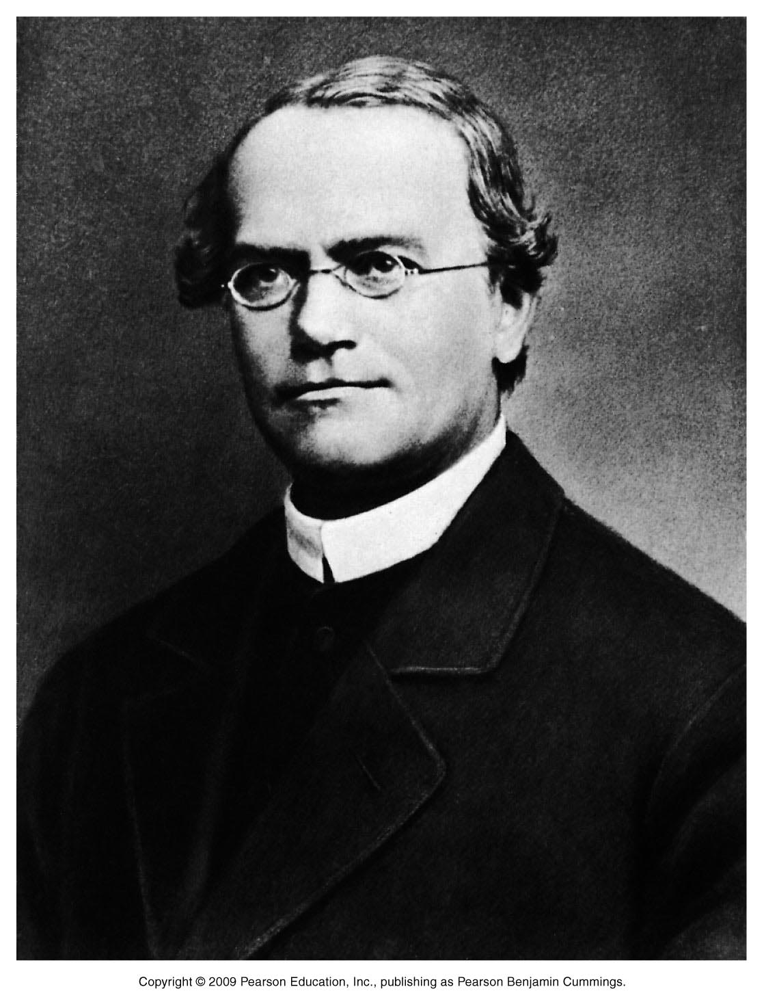
Inheritance (a.k.a. Heredity) is the passing down of traits from parents to offspring or from parent cells to daughter cells.
Mendelian Inheritance – inheritance of simple traits from parents to offspring
Simple traits – traits defined by only one gene
Follow Inheritance Laws defined by Gregor Mendel
Gregor Mendel
Father of Genetics!
Austrian Monk, Physicist and Mathematician
Gregor Mendel (1860’s)

Slide 4
Back in the 1800’s
Even without Science, people knew traits were passed from parents to kids – “see the resemblance”
People thought that the traits from the parents “blended” in the kids – “Blending of the traits”
Mother has blonde hair and black eyes
Father has black hair and brown eyes
Child looks like mother and father:
Black hair and black eyes

Slide 5
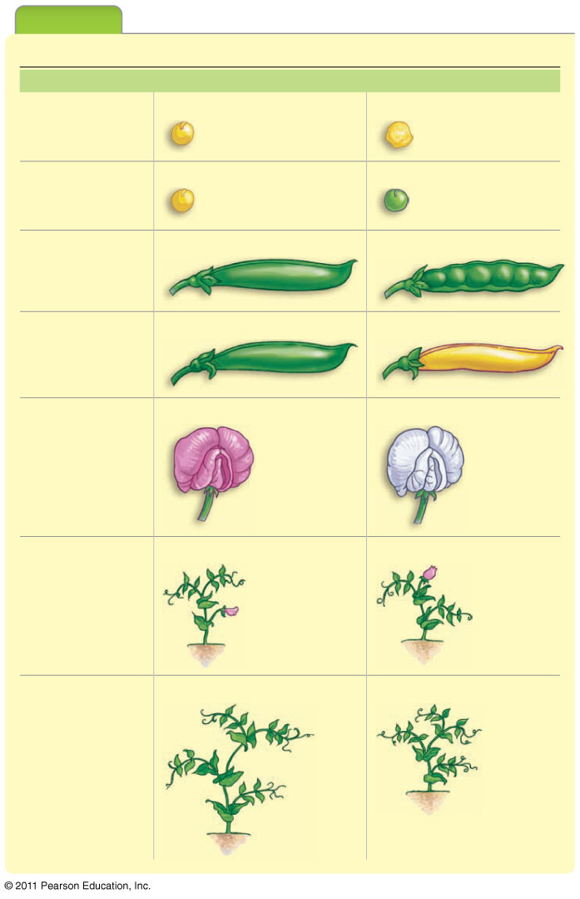
Pea-Plant Characters Studied by Mendel
Trait Studied
Dominant Trait
Recessive Trait
Mendel worked with Pea plants
Experiment: Mated plants with different traits and observing the offspring
Why Pea plants?
They are sexually reproducing, with pollen and ova as haploid gametes
Their breeding (through pollination) can be easily controlled
They exist in several varieties with different, easily identifiable traits
He studied 7 traits (see table)
Each trait has two possible versions
smooth
wrinkled
Seed shape
yellow
green
Seed color
inflated
wrinkled
Pod shape
green
yellow
Pod color
purple
white
Flower color
on stem
at tip
Flower
position
tall
dwarf
Stem length

Slide 6
Speaking Genetics: Important Terms
Alleles – matching genes on matching chromosomes that code for the same trait or characteristic, one each from female and male gametes
Genetic cross – experimentally mating organisms to produce offspring
Self-cross - using one plant with both sexes to make offspring
Cross-breeding – mating two organisms (using 2 plants)
Parental generation – source of original gametes, abbreviated with P
First generation – offspring of the P, abbreviated F₁
Second generation – offspring of the F₁, abbreviated F₂
Third generation – offspring of the F₂, abbreviated F₃

Slide 7
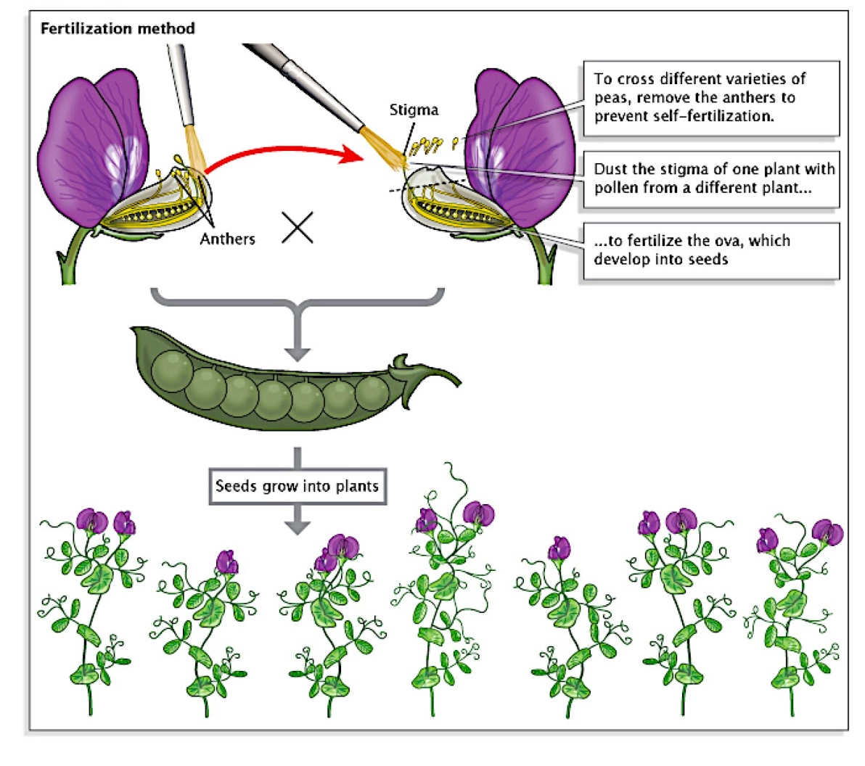
Mendel’s Experiment Set-up

Slide 8
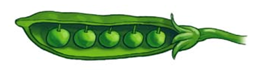
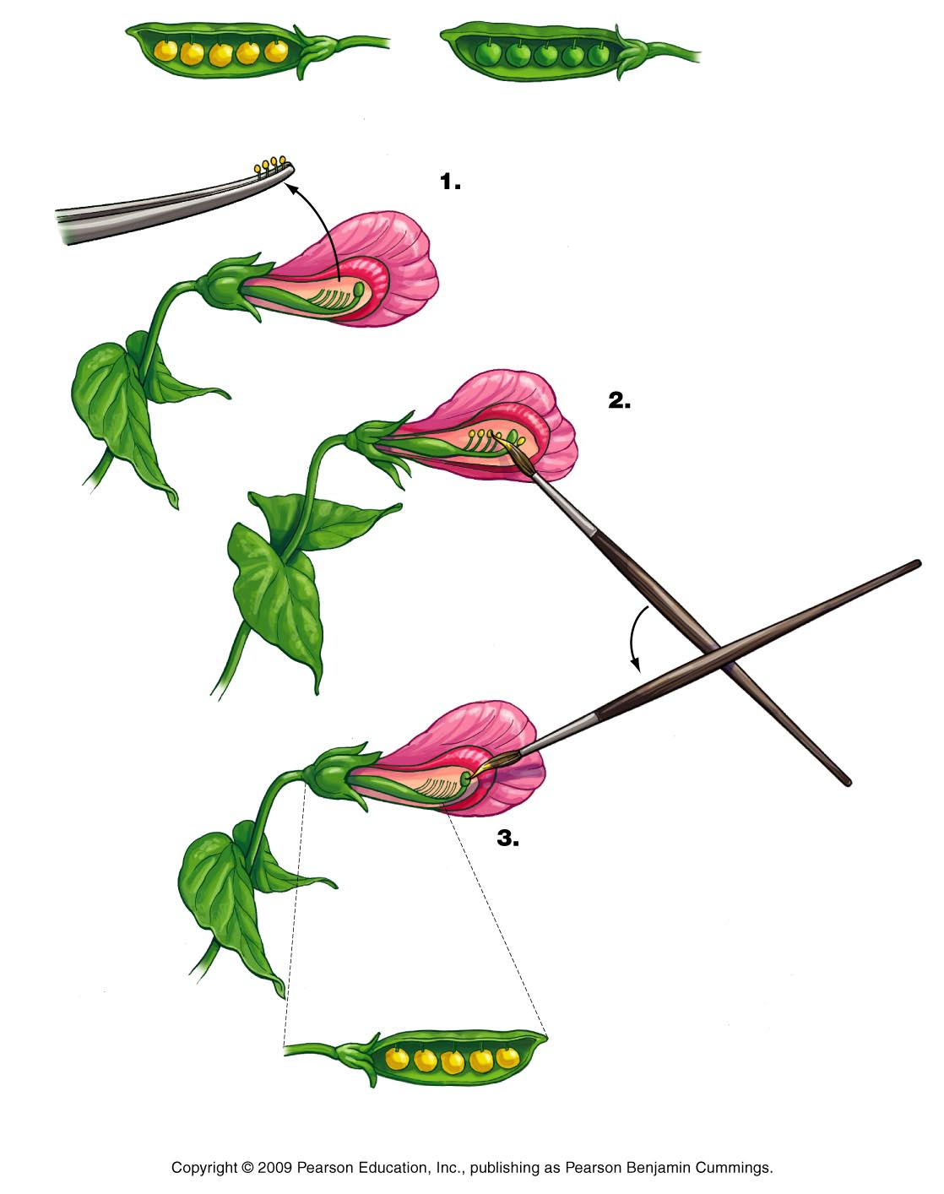
Mendel’s Control Experiments: Crossing “pure-breeds”
Crossing “pure-breeds” always resulted in offspring that look like the parents
same result if self-crossing or cross-breeding plants
example: pea plants that are “pure-breeds” for seed color
Self-cross
Cross-bred
Trait tested:
Gene for seed color
Alleles: yellow seeds and green seeds
P :
pure-breed yellow seeds
pure-breed green seeds
F₁ :
ALL F₁ plants will have yellow peas
ALL F₁ plants will have green peas

Slide 9
Experiment 1: Cross-breeding 2 plants with different traits
Mendel cross-bred the pollen (sperm) from a yellow seed pure-breed plant with a green seed (egg) pure-breed plant
P :
pure-breed male
pure-breed female
F₁ Expected Results: Hypothesis
Traits from both parents would “blend” to make yellow-greenish seeds
“Blending of the traits”

Slide 10
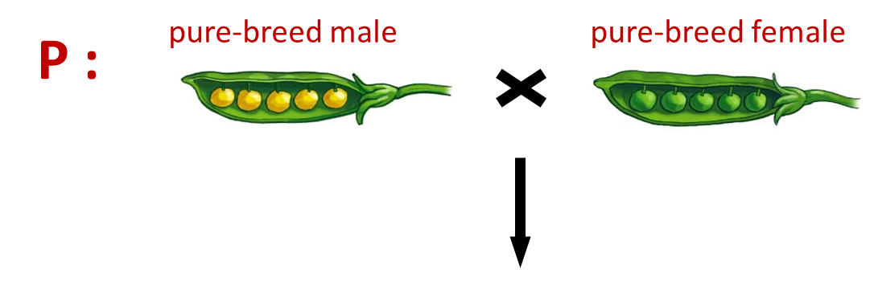
Actual Results:
F₁ :
SURPRISE! ALL the offspring of this cross were plants with yellow seeds!
100% of F₁ offspring had yellow seeds
Seems like the green seeds disappeared
Traits are not blended!

Slide 11
Experiment 2: Self-crossing the F₁ from Experiment 1
Mendel “self-crossed” the F₁ plants to see what the resultant offspring (F₂ generation) would look like
F₁ :
F₂ : Expected Results: Hypothesis
ALL offspring will have yellow seeds (just like before)

Slide 12
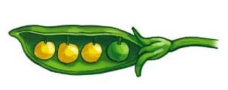
Actual Results:
SURPRISE! Plants with green peas came back!
75% of F₂ offspring had yellow seeds
25% of F₂ offspring had green seeds
Trait for green seeds did not disappear!
Mendel’s Conclusions:
Green seed trait WAS present in the F1 plants but not seen
Green seed trait was “masked” by the yellow seed trait
F₁ :
F₂ :

Slide 13
Modernization of Mendel’s Conclusions
Traits in Pea plants are controlled by “factors”
One “factor” controls one trait (Example – One “factor” controls seed color)
We now know Mendel’s “factors” are genes
A single Pea plant contains two “forms” of each “factor” that controls a given trait
Example – “factor” that controls seed color has two “forms”: yellow and green
We now know Mendel’s “forms” are alleles
The “two forms” present in a single plant refer to the two alleles present in Homologous Chromosomes in the diploid adult
Pea plants pass only one of the two “factors” to their offspring
Meiosis reduces the DNA in each gamete to just one of each chromosome pair

Slide 14
Phenotype – physical appearance – observed trait of an organism
Genotype – genetic make-up of an organism (genetic information present in the allele)
If the 2 alleles are the same version of a trait, the organism is homozygous for that trait
If the 2 alleles are different versions of a trait, the organism is heterozygous for that trait
When 2 different versions are present, one version may dominate the other
Dominant allele – version that masks another (Abbreviated with uppercase letter = A,B,C)
Recessive allele – version that gets masked (Abbreviated with lower case letter = a,b,c)
Organism is “hybrid” if “self-crossed” will make plants with both versions
Organism is “pure-breed” if “self-crossed” will only make plants that look like the parent
Some groups have considered this preferable over the years but genetic diversity is healthier

Slide 15
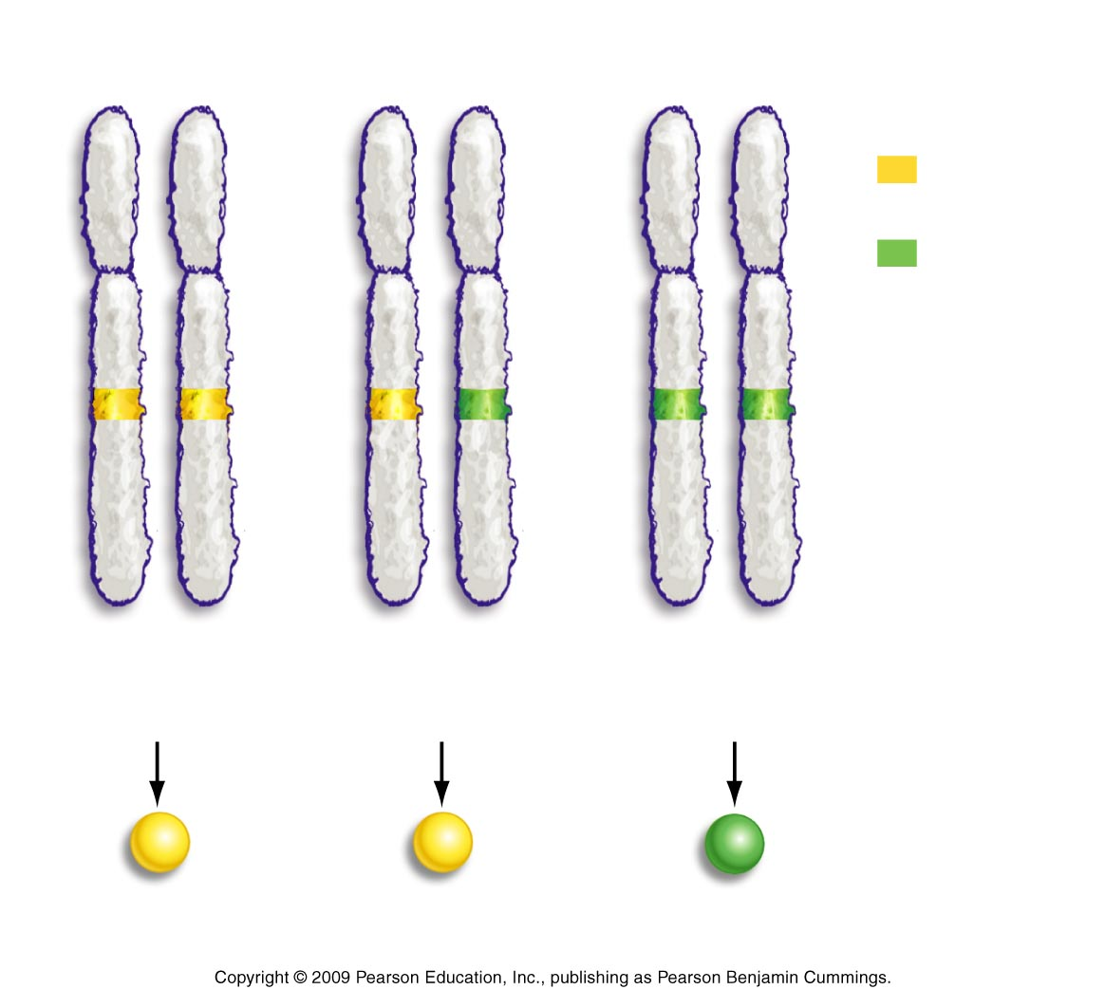
Alleles for seed color: three possible Genotypes
One for yellow, one for green
Both alleles are for yellow seed
Both alleles are for green seed
homozygous dominant
(YY)
heterozygous
(Yy)
homozygous recessive
(yy)
Seed color seen in plants: Two possible Phenotypes
Yellow
Yellow
Green

Slide 16
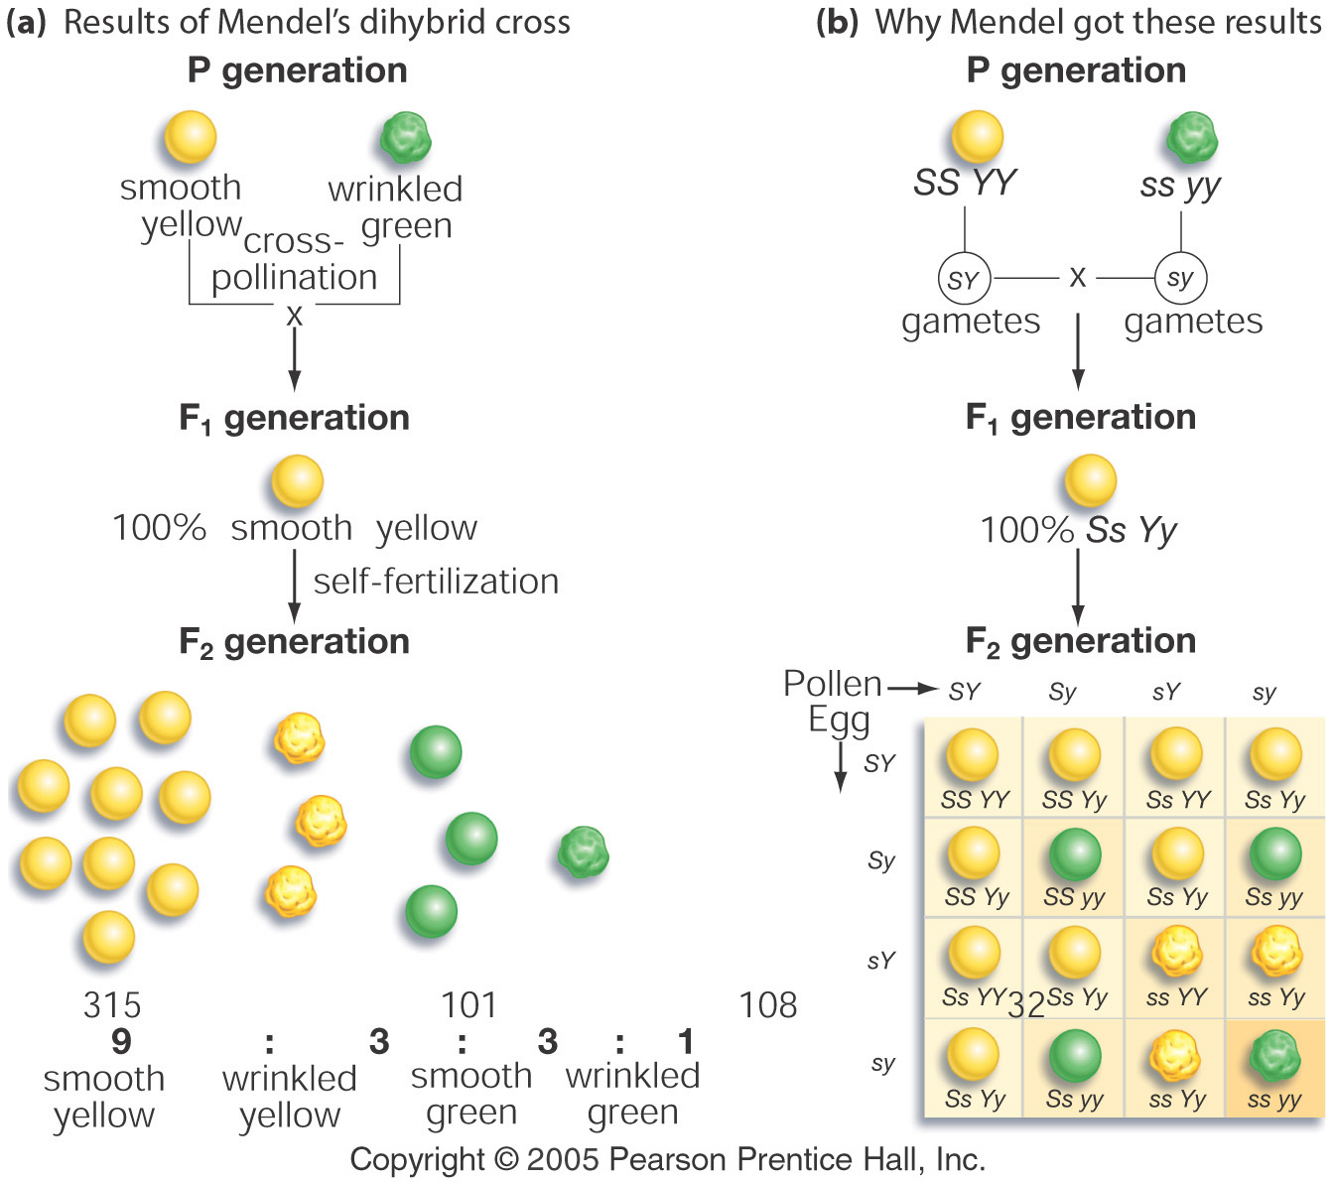
Mendel’s Third Type of Experiment: Crosses with Two Traits
Mendel crossed two “pure-breed” plants with two traits each
Traits for seed shape and color:
Parent #1 – smooth yellow seeds
Parent #2 – wrinkled green seeds
Result: F₁ was 100% smooth yellow peas

Slide 17
Mendel’s interpretation based on his Laws holds up very well:
Because 100% F₁ is “smooth and yellow”, both “wrinkled and green” were masked
Parent #1 – “pure-breed” smooth yellow seeds = SSYY (both dominant)
Parent #2 – “pure-breed” wrinkled green seeds = ssyy (both recessive)
#1
SY
SY
#2
s y
S Y
S Y
sy
s y
F₁ Genotype: 100% SsYy
Dihybrid Heterozygous
sy
S Y
S Y
s y
s y

Slide 18
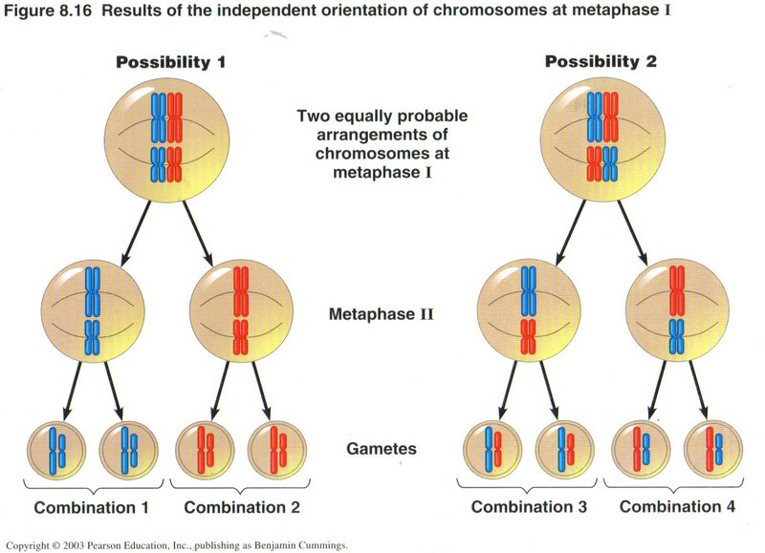
The Law of Independent Assortment
If parent’s genotype is double heterozygote, YySs, it can make 4 gametes
Gametes: YS, Ys, yS and ys
y
s
y
s
Y
S
Y
S
y
S
y
S
Y
s
Y
s
ys
YS
yS
Ys

Slide 19
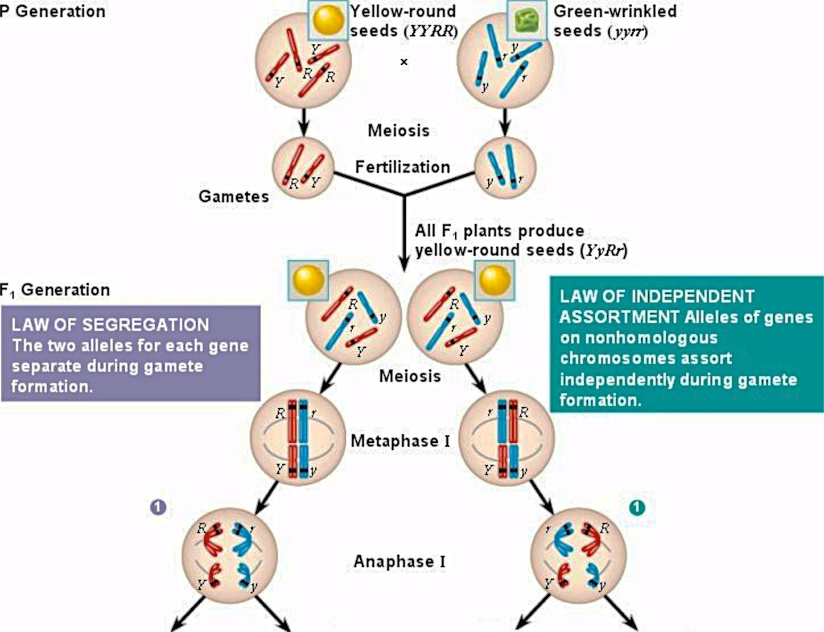
Gametes: RY ry rY Ry

Slide 20
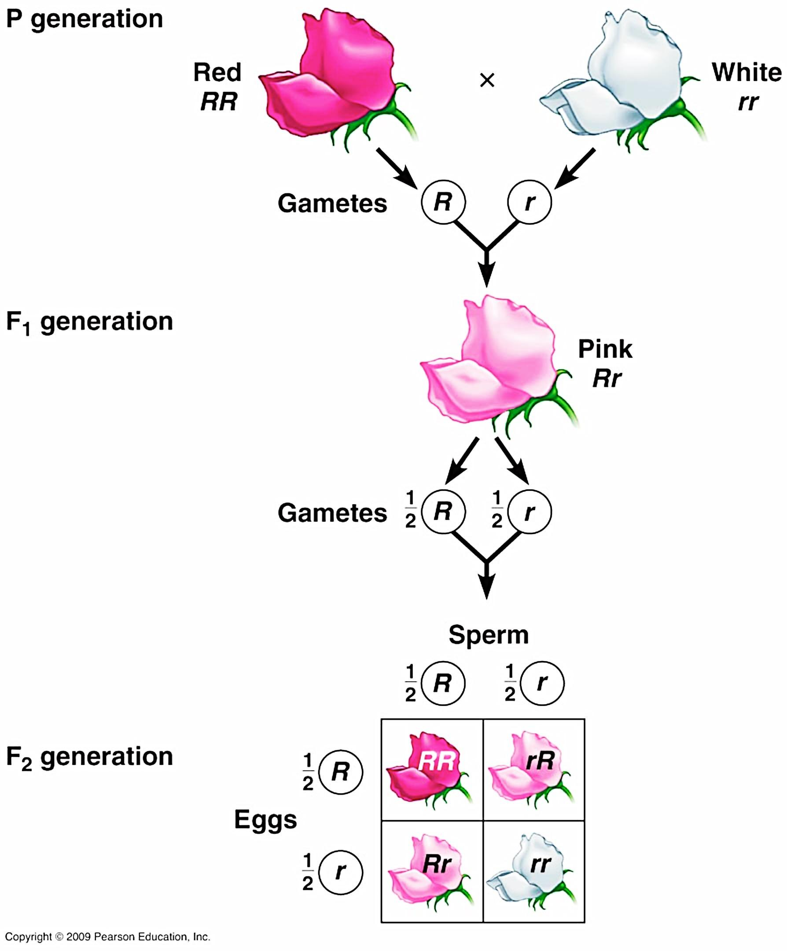
Non-Mendelian Inheritance: Incomplete Dominance
Heterozygote shows intermediate trait from both alleles
Incomplete dominance leads to an intermediate phenotype in the heterozygote
It may seem like traits are blending in F₁ generation
However, the parental traits return in the F₂ (no blending)
In the heterozygote, neither allele is completely masked by the other

Slide 21
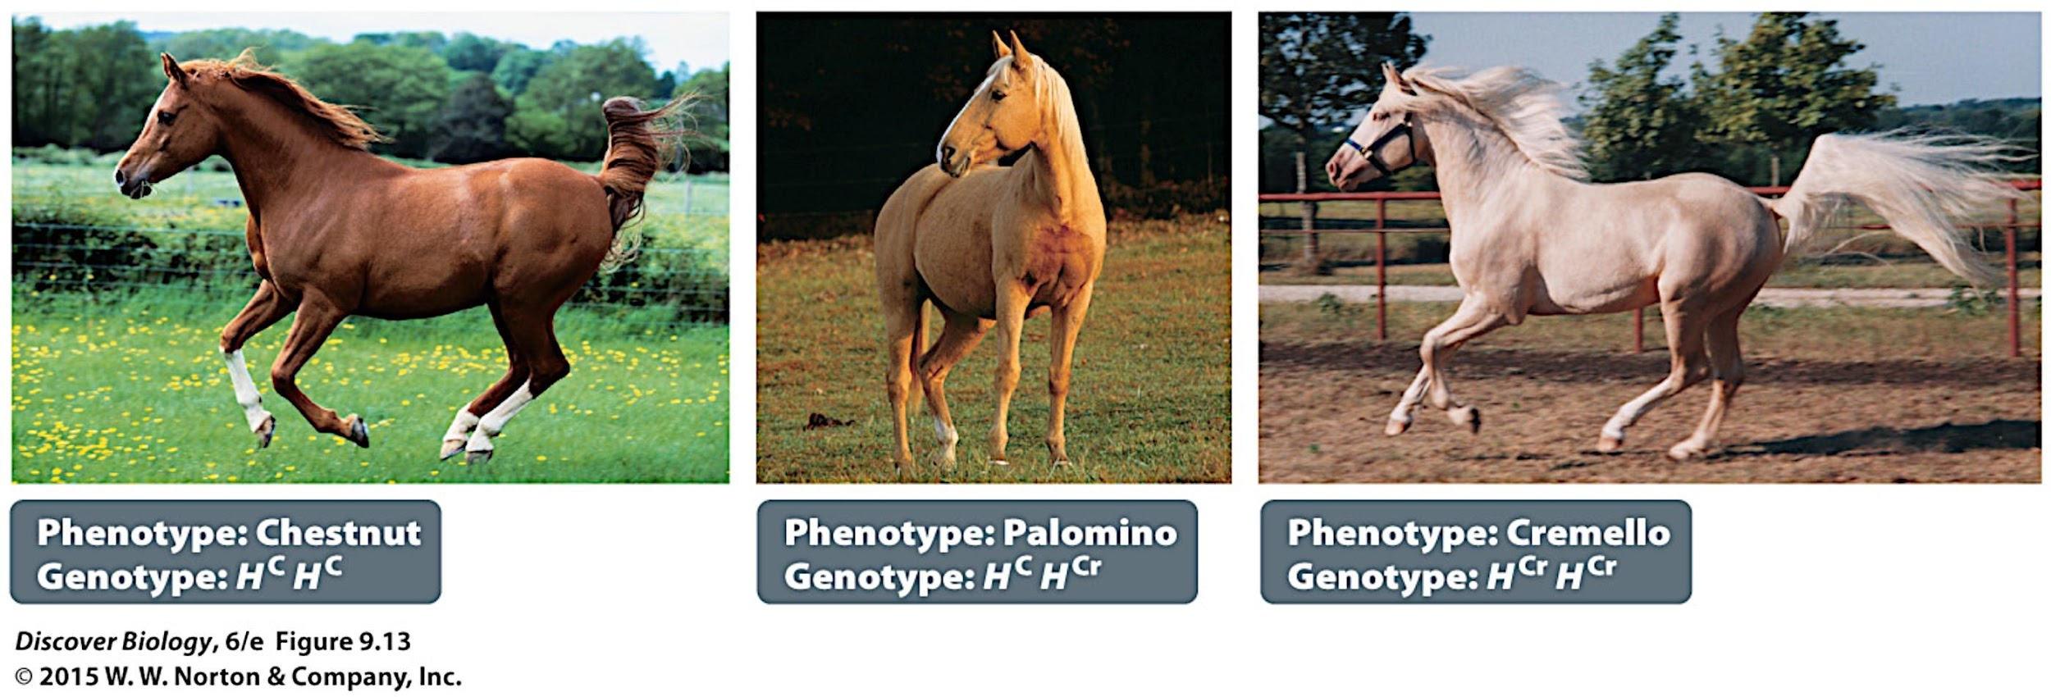

Non-Mendelian Inheritance: Incomplete Dominance (Examples)
AA AT TT

Slide 22
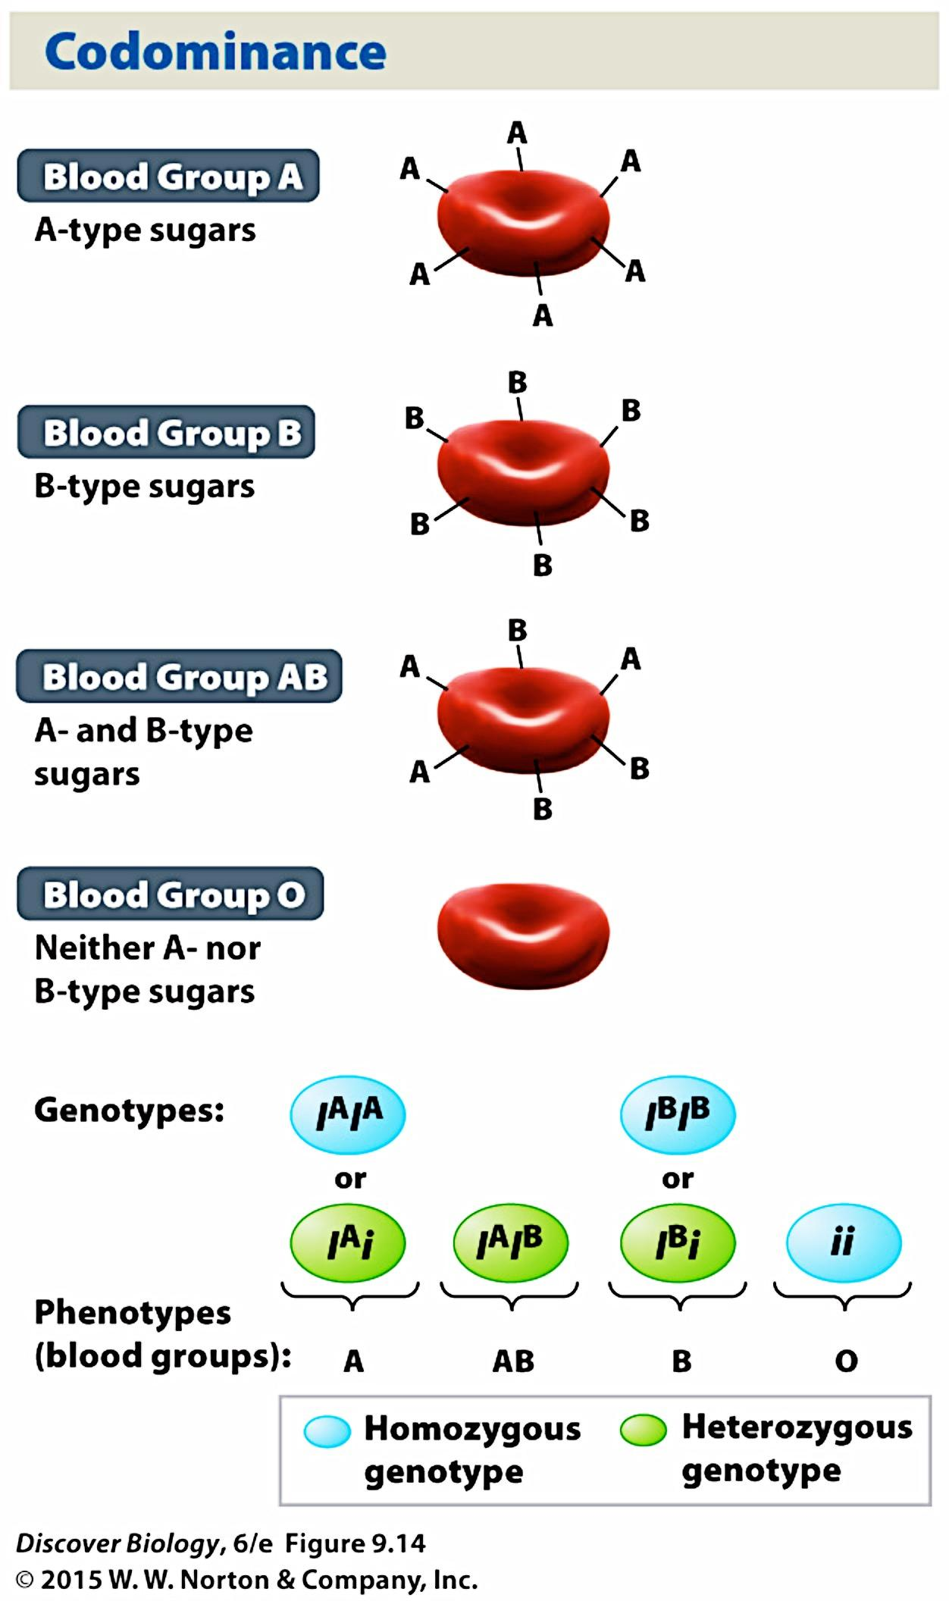
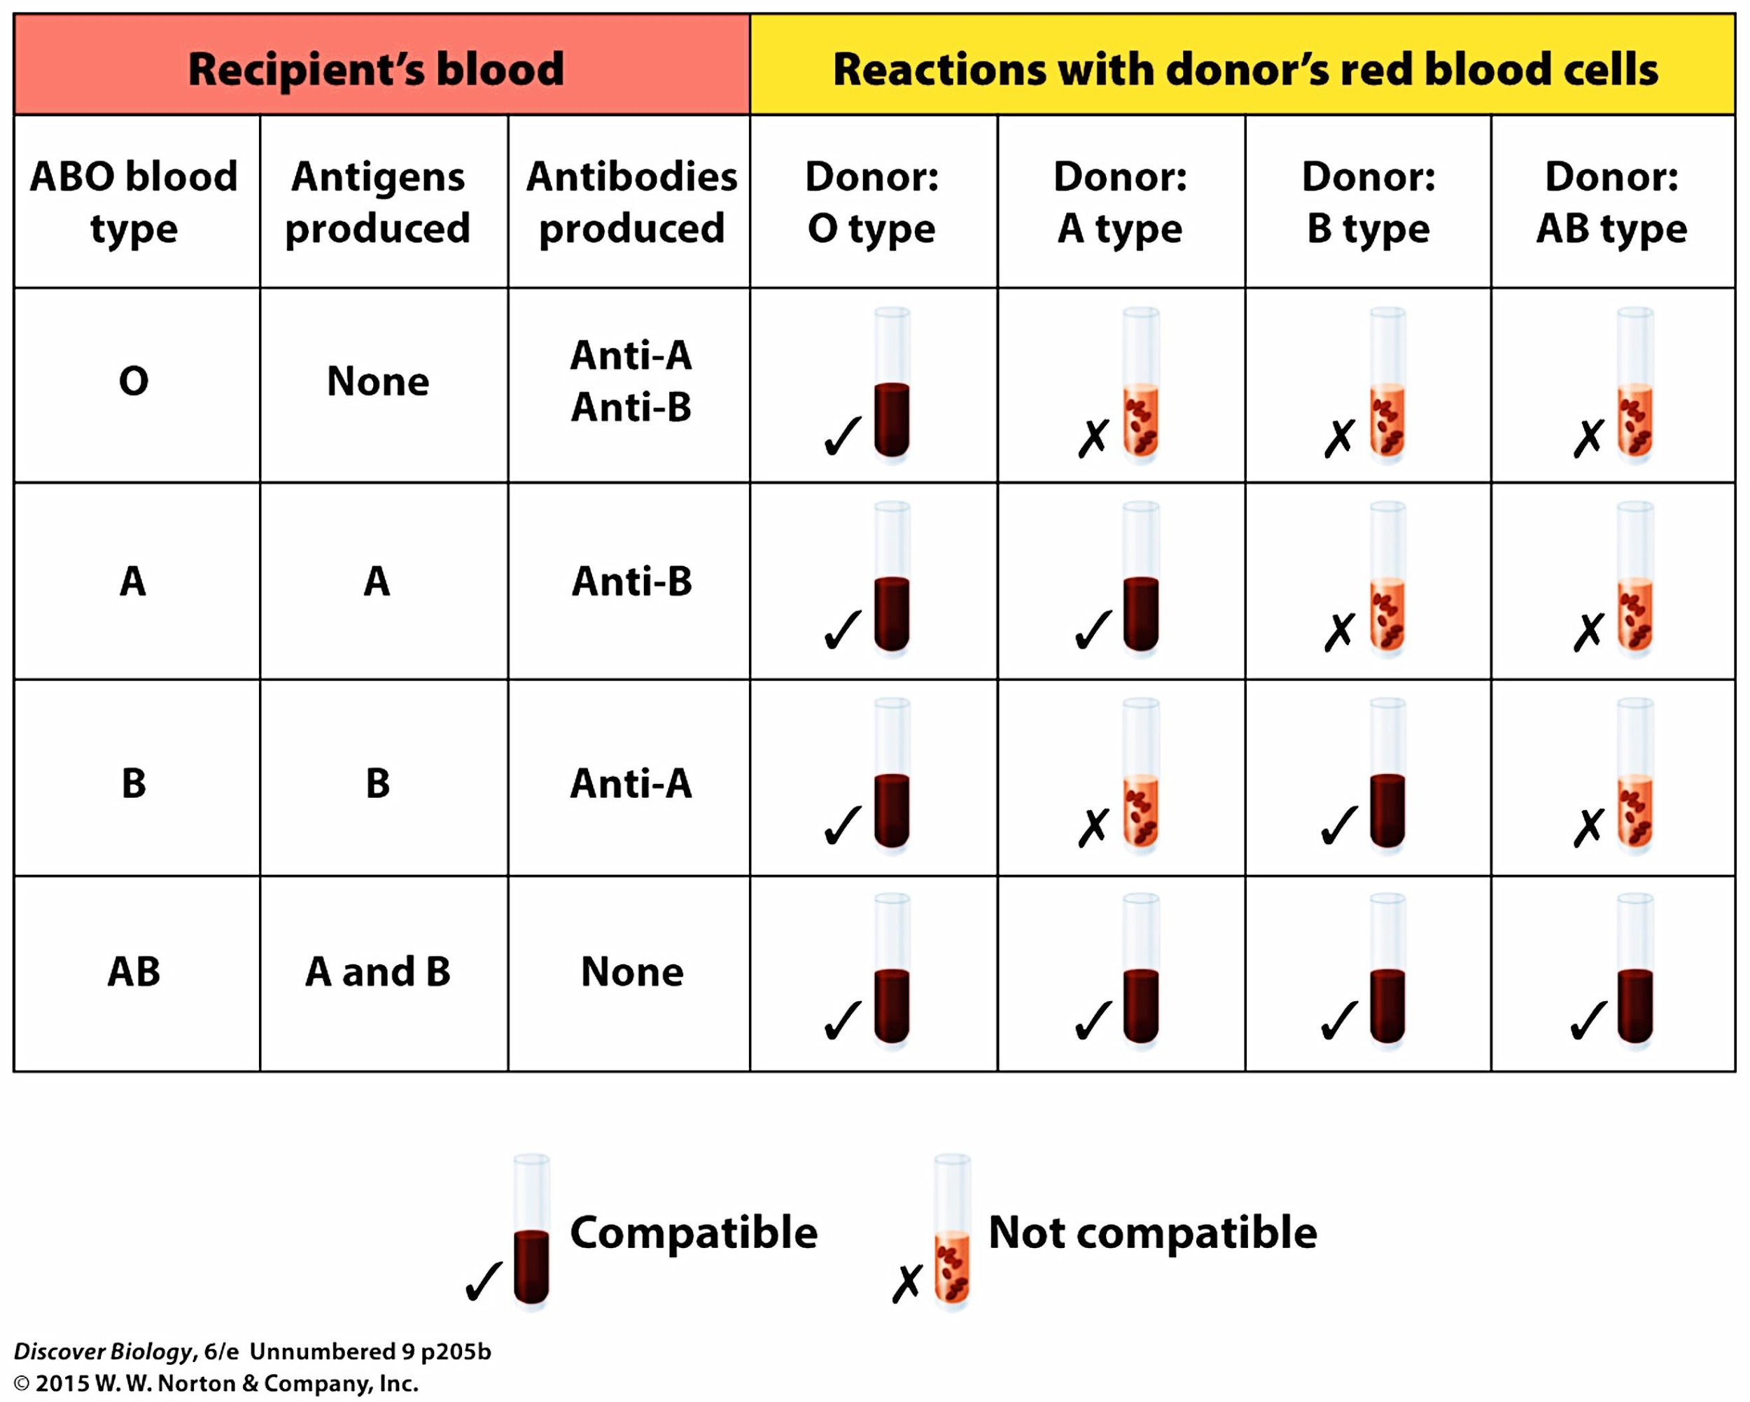
Non-Mendelian Inheritance: Codominance - Heterozygote shows both alleles
ABO blood types determined by sugars covalently attached to the cell surface on red blood cells (RBC)
The I gene encodes an enzyme that comes in at least three allelic forms: the form encoded by the I^{A} allele adds “A-type” sugars to RBCs, and the form encoded by the I^{B} allele adds “B-type” sugars
The i allele codes for a nonfunctional version of the enzyme; individuals who have two copies of the i allele have neither A-type nor B-type sugars

Slide 23
The Existing Genomes in the World
The number of bases and the complexity of their organization vary far more than the number of genes
The conservation of critical functions and the base sequence of the genes that code for them show that all cells are related
These close structure and function relationships allow us to gain information about ourselves from a wide variety of organisms

Slide 24
Life’s genetic complexity is less than you think.
The smallest genome: Mycoplasma genitalia has 477 genes (580,070 bases)
The largest animal genome: The waterflea, Daphnia pulex, has 31,000 genes (200M bases)
Arguably, the most complex: Homo sapiens has ~24,000 genes and ~3 billion bases in our 46 chromosomes.
There is a fundamental ‘core’ of genes shared by ALL organisms of about 60 genes

Slide 25
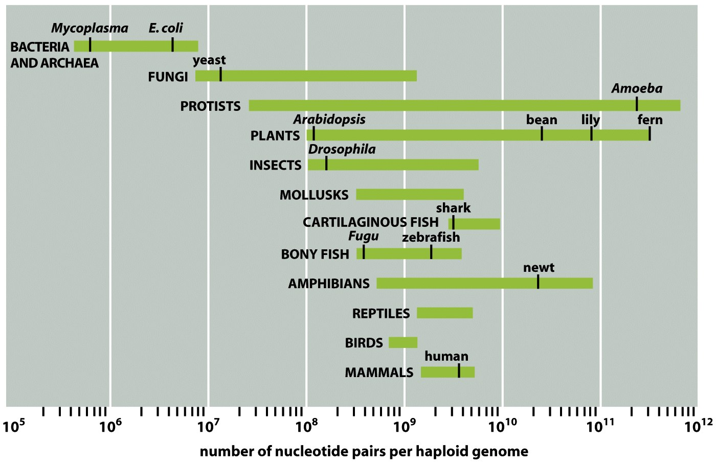
Figure 1-37 Molecular Biology of the Cell, Fifth Edition (© Garland Science 2008)

Slide 26
How much do we really know about any organism?
Mycoplasma genitalium: 477 genes, 580,070 basepairs
37 code for non-messenger RNAs
297 of the 440 that code for protein are ‘known’
153 processing of DNA, RNA, protein
71 involved in metabolism
33 involved in nutrient transport
29 involved in surface membrane
11 involved in cell division
143 remain unidentified

Slide 27
Prokaryotic cells
DNA is a single, circular double helix containing 10⁶-10⁷ base pairs and 1,000-6,000 genes
Eukaryotic cells
Chromosomes are linear DNA molecules (fruit flies have 10, we have 46, dogs 78, etc.)
Smallest chromosome in humans is 2 million bases, total DNA is 3.2 x 10⁹ base pairs
As animals become more complex, not just more DNA in the nucleus, embedded controls for expression become more complex
Our chromosomes are 50% protein!!
Plants have greater tendency to have [DNA] change

Slide 28
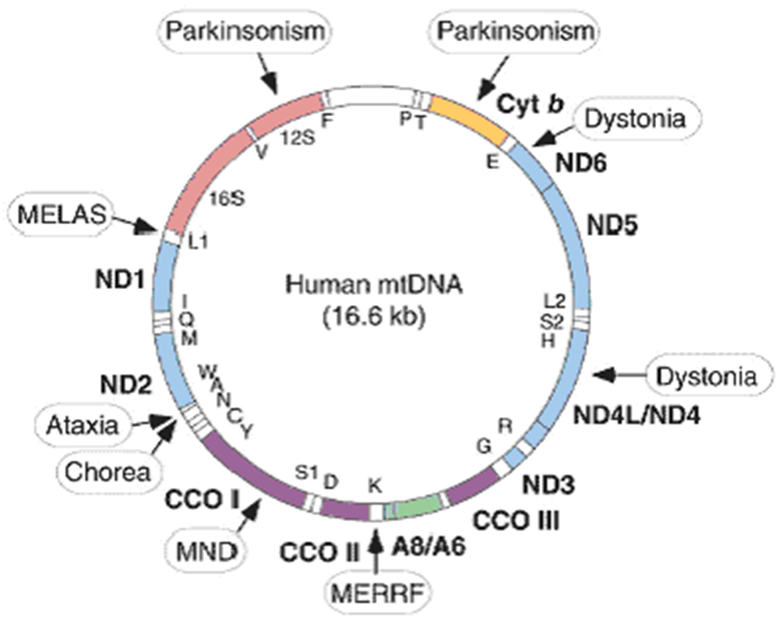
Eukaryotes also have genes in their mitochondria and/or chloroplasts
Our mitochondria have a genome of 16,569 base pairs which codes for:
13 proteins
2 ribosomal RNA components
22 transfer RNAs
The rest of the functional DNA
components for mitochondrial
function reside in the nucleus

Slide 29
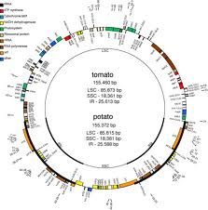
Chloroplast Genome
Usually 110-120 genes
Some as high as 200

Slide 30
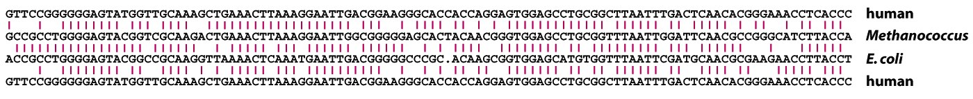
Gene Conservation and Model Organisms
1. If the function is essential and unchanged, the structure (sequence) must be unchanged - because you’d die if you lost an essential function.
2. Example 1: All cells from bacteria to Archaea to humans have extremely high sequence homology (structure) in the small ribosomal sub-unit because they use the same mechanism to express DNA (function).
3. Example 2: MADS-box family transcription factors have been found in every eukaryotic cell type on Earth: MEF-2, agrafens, deficiens, SRF

Slide 31
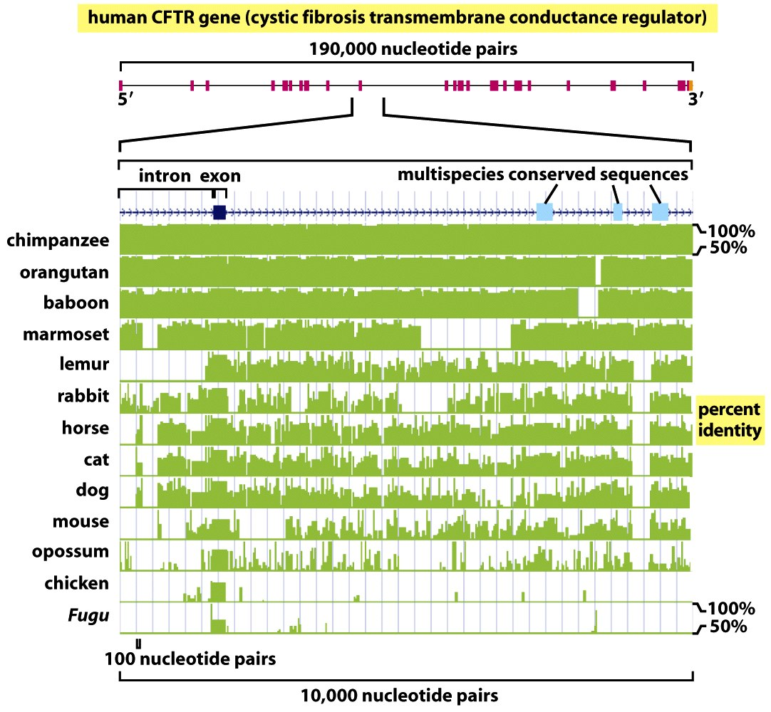
The closer the taxonomic relationship between two species, the closer the sequence homology at any given site in the DNA
The DNA sequence in humans and chimps is almost 99 percent identical.
When DNA insertions and deletions are taken into account, humans and chimps still share 96 percent of their sequence.
As of 2015, the typical difference between the genomes of two individual humans was estimated at 20 million base pairs (or 0.6% of the total of 3.2 billion base pairs).

Slide 32
The Genetics of “Race”
Race refers to a person's physical characteristics, such as bone structure and skin, hair, or eye color, placing them into pure and static groups that are significantly different from one another.
Since those are genetic traits, the logic goes, race itself must be genetic, and there must be differences that are more than skin deep.
Modern genetic techniques (karyotyping, DNA hybridization, protein sequences, and nuclear and mitochondrial base sequences from ancient and modern DNA) undermine the whole concept that humanity is composed of ''races''.
The evidence is clear that populational, but not racial, differences exist within the human species.
Modern scholarship regards race as a social construct, an identity assigned based on societal rules
While partially based on physical similarities within groups, race does not have an inherent physical or biological meaning.

Slide 33
Modern Tools for Tracking People Genetically
Mitochondrial DNA (mtDNA).
Mitochondria have their own DNA, separate from the DNA that actually makes a person.
Mitochondria are not in sperm cells; therefore, they are inherited only from the mother.
They record a person's matrilineal heritage
The Y Chromosome.
Women lack the Y chromosome
It is inherited strictly from father to son.

Slide 34
What Does the Data Show? We are all descended from a single, small group.
mtDNA indicates all living humans descend from one maternal source, Mitochondrial Eve, who lived in Africa between 100,000 and 200,000 years ago.
Y chromosome data shows that all men have a common ancestor, Y-chromosome Adam, who lived at the same time (the fact that they match makes this evidence much more convincing).
Both analyses indicate that modern humans descend from a small founding population of about 5000 men and an equal number of women.
All data patterns indicate steady genetic mixing among humans living near enough to interact.
Patterns of variation of human genetic traits show more abrupt shifts at places where steady gene flow is interrupted than at physical places associated with subpopulations.
Such patterns can be explained by the expansion of the human population from Africa and serial genetic bottlenecks, such as the plague in Europe.

Slide 35
Most Variations Reflect Environmental, Not Human, Differences
Skin color is an adaptation to sunlight that provides protection from skin cancer, yet allows for vitamin D production in the skin. Lighter skin arose as a response to weaker sun in temperate regions.
Body height is considered a polygenic trait that is very much affected by inheritance. Population variations tend to reflect environmental stressors, such as malnutrition and infectious disease.
Some genetic differences correlate with historical exposure to different infectious diseases.
Hemoglobin variants provide defense against infection by the malaria bacterium (Plasmodium).
Sickle-cell anemia in people of African descent
Thalassemia in people of Mediterranean descent
Environmental selection pressures have caused more than 300 variants of hemoglobin
Cystic fibrosis causes the buildup of mucus in the respiratory tract, leading to death from infection.
The heterozygous condition for CF protects against extreme dehydration due to cholera.

Slide 36
The Concept of Human “Races” was Based on Poor American Science
Eugenics is a set of beliefs and practices aimed at improving the genetic quality of the human population.
It played a significant role in the history and culture of the United States during the Progressive Era, from the late 19th century until US involvement in World War II.
While ostensibly about improving genetic quality, it has been argued that eugenics was more about preserving the position of the dominant groups in the population.
Progressive-era US eugenics is now generally associated with racist and nativist elements, as the movement was to some extent a reaction to a change in emigration from Europe, rather than scientific genetics

Slide 37
Eugenics was widely accepted in the U.S. academic community.
The American Breeder's Association, the first eugenic body in the U.S., was expanded in 1906 specifically to "investigate and report on heredity in the human race, and emphasize the value of superior blood and the menace to society of inferior blood.“
Membership included Alexander Graham Bell, Stanford president David Starr Jordan and Luther Burbank
By 1910, there was a large and dynamic network of scientists, reformers, and professionals engaged in national eugenics projects and actively promoting eugenic legislation.
By 1928, there were 376 separate university courses in some of the United States' leading schools, enrolling more than 20,000 students, which included eugenics in the curriculum

Slide 38
Worldwide Impacts of the Eugenics Movement
In the first half of the 20th Century, the Nazis justified the death camps on the grounds that Jews and Gypsies were genetically inferior
The Nazis took their cue from eugenics legislation passed in the United States. Eugenics was practiced in the United States many years before eugenics programs in Nazi Germany, which were largely inspired by the previous American work.
The state of California was at the vanguard of the American eugenics movement, performing about 20,000 sterilizations or one third of the 60,000 nationwide from 1909 up until the 1960s.
While California had the highest number of sterilizations, North Carolina's eugenics program which operated from 1933 to 1977, was the most aggressive of the 32 states that had eugenics programs. An IQ of 70 or lower meant sterilization was appropriate in North Carolina.
Stefan Kühl has documented the consensus between Nazi race policies and those of eugenicists in other countries, including the United States, and points out that eugenicists understood Nazi policies and measures as the realization of their goals and demands.

Slide 39
Ethnicity is Real, Race is Not
An ethnic group or ethnicity is a category of people who identify with each other, usually as an inherited status based on the society in which one lives.
Membership of an ethnic group tends to be defined by a shared:
Cultural heritage, physical appearance, ancestry, history
Homeland, language or dialect, or social treatment within their residing area
Symbolic systems such as religion, origin myth, mythology and ritual
Cuisine, dressing style, art.
Ethnic groups often speak related languages and, over time, begin to share a similar gene pool.
New members can be absorbed into an ethnic group by way of language shift, acculturation, adoption and religious conversion.

